Slide 1
Animal In Shelter
What affects how long animals are kept in shelter？
Group-19
Sun Xuan, Yang Tianjian, Sheng Yahan, Wu Xiaoyan, Liu Yuchen

Slide 2
Introduction
An animal shelter is a place that takes in lost or abandoned animals. Its goal is to provide a safe and comfortable environment for homeless animals while attempting to relocate or reunite the animals with their owners. Most animal shelters will only keep animals for 7 to 14 days, during which time they will provide the animals with basic needs, including food, water, medical care and shelter. If you can’t wait for the owner to take it back, or get a new owner to adopt it, most of these animals will be more humane. Only a few countries have laws to prohibit the killing of stray dogs (CFHS, 2015).

Slide 3
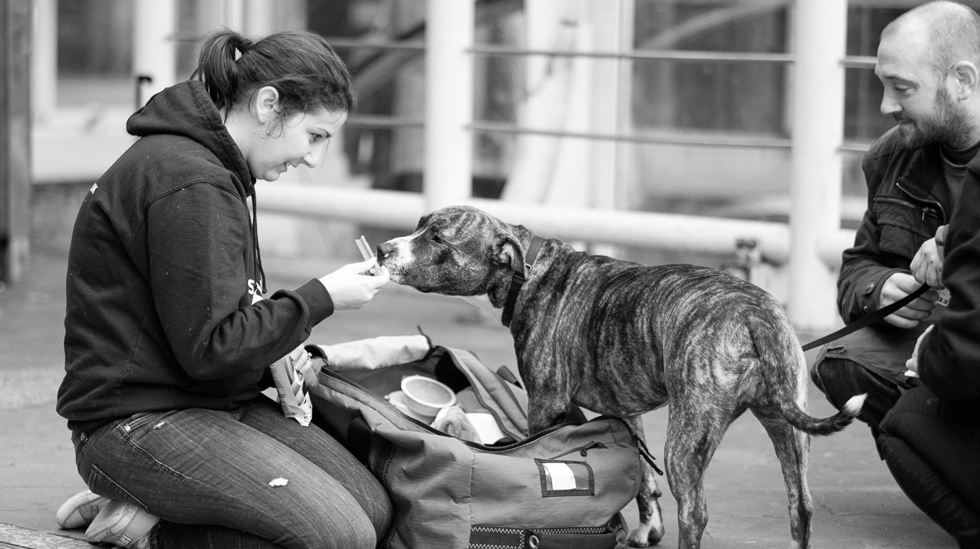
Introduction
StreetVet was born in 2016, inspired by the incredible bond between a homeless man and his dog. Now StreetVet vets and nurses have helped care for over 1000 street dogs (some cats and rabbit!). They We have vaccinated and microchipped; treated for fleas and protected against lungworm; prescribed pain relief and helped fight infections; performed surgeries.

Slide 4
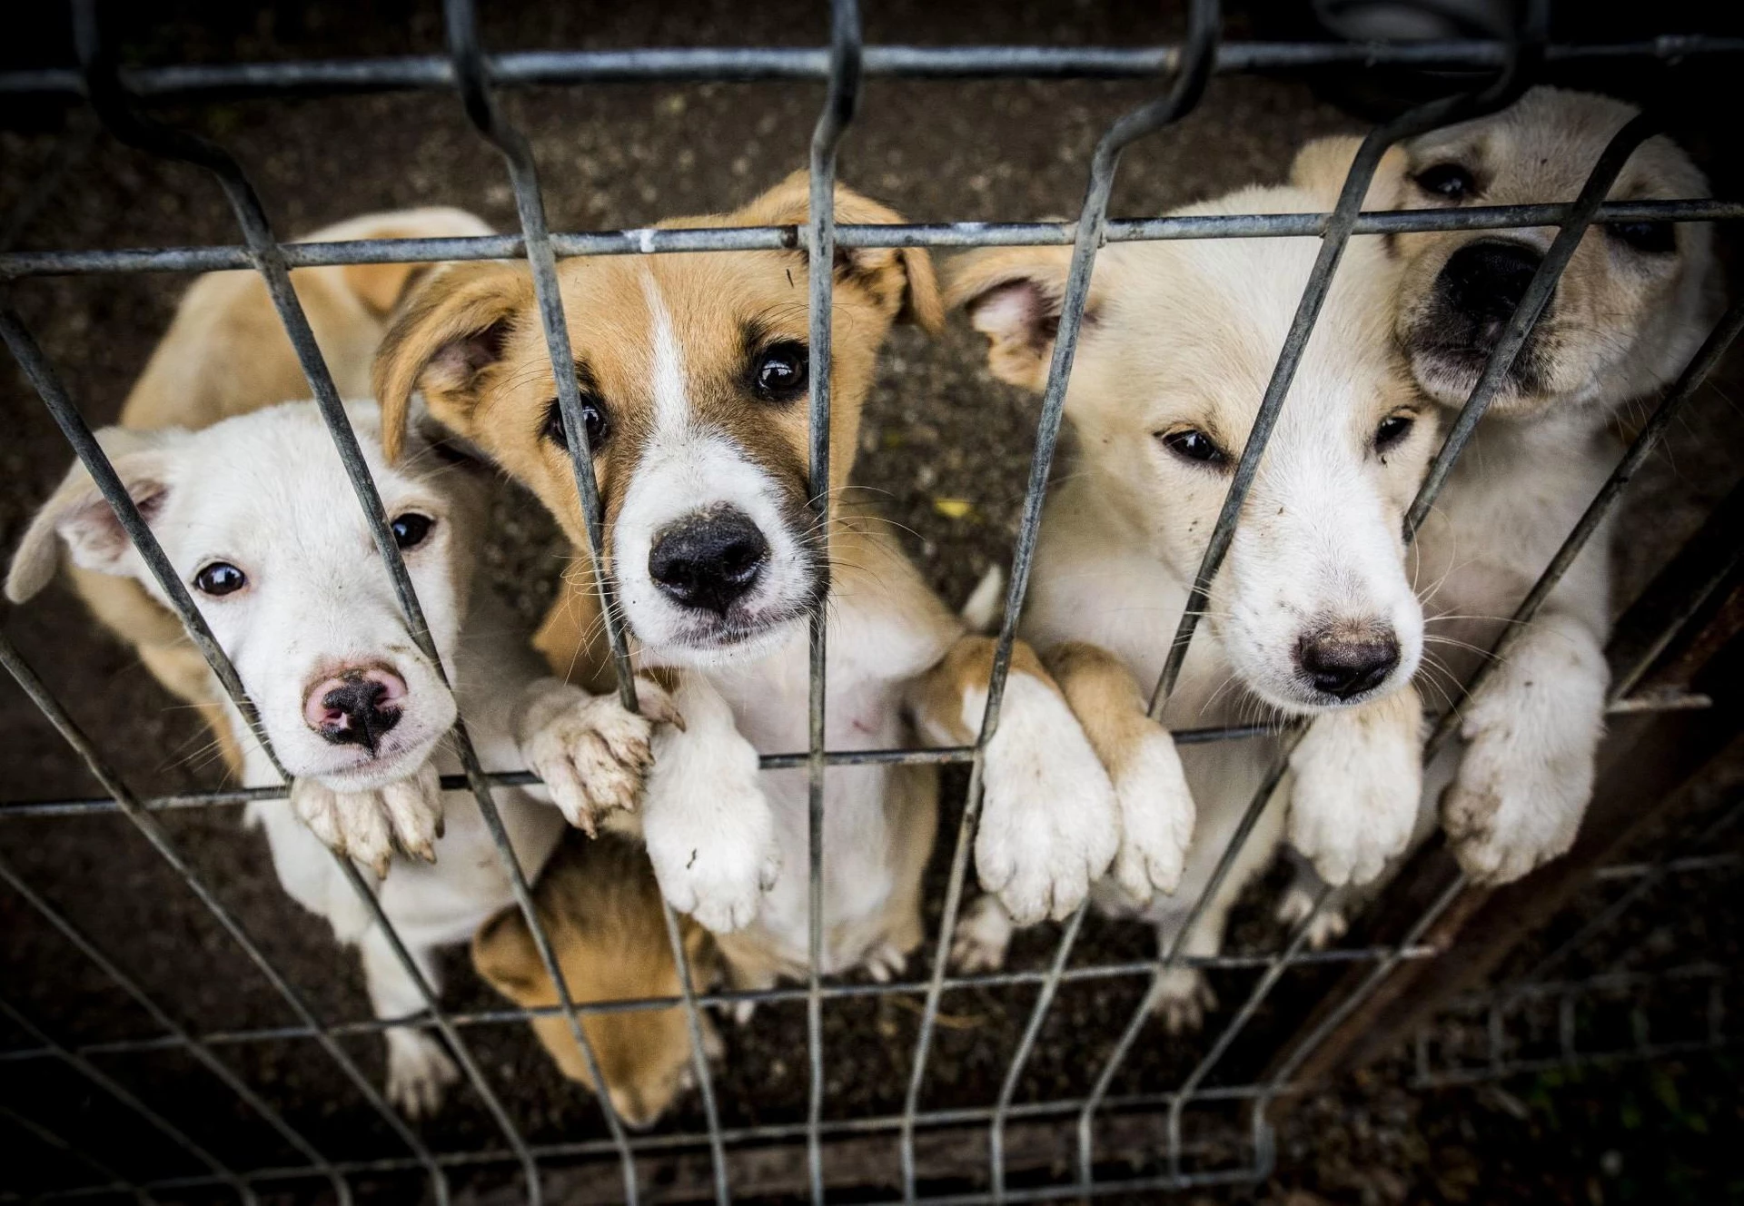
Research Purpose
Animals are often sent to shelters for a variety of reasons, such as homeless strays being helped or pets who have been cruelly abandoned by their owners. Sheltered animals are treated humanely in the shelter until they are re-adopted. Generally speaking, dogs are liked by most people, but according to the data collected, dogs stay in the shelter the longest. Exactly what factors cause different animals to spend different amounts of time in shelters (compared to other animals) is worth thinking about and studying.

Slide 5
Exploratory Data Analysis
From the collected data, the response variable is the Time the animal was kept in the shelter, and there are six explanatory variables, which namely:
Animal type: Cat, Dog, Bird or other Wildlife.
Month: The specific month the animal was sent to the shelter.
Year: The specific year the animal was sent to the shelter.
Intake type: The type of shelter being sent, such as stray animals, abandoned pets, etc.
Outcome type: Types of when leaving the shelter, such as adoption or euthanasia.
Chip status: Animals at shelters with or without microchips.

Slide 6
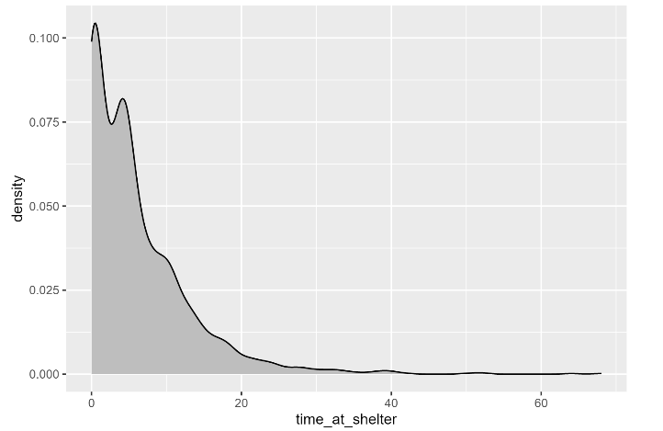
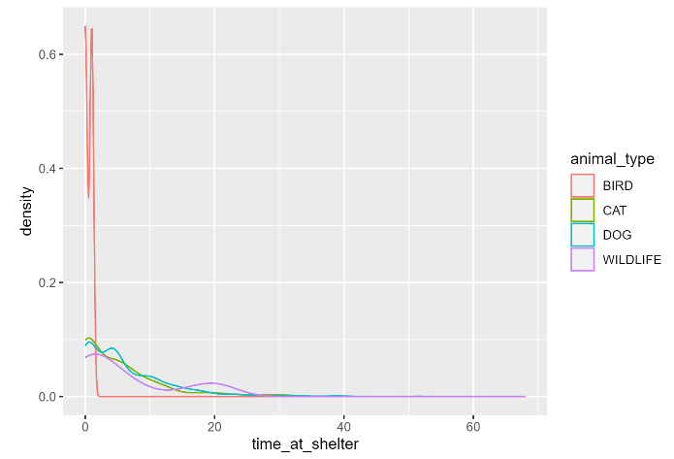
The Density Function Of Variables
First, investigate what kind of density function of response variable (Time the animal was kept in the shelter) and differents animals, whcih can be used for choosing the GLM model.

Slide 7
The Density Function Of Variables
Through the classic Poisson distribution shown in the two graphs on the previous page, choosing logit link function combined with the assumption that the response variable obeys the possion distribution for GLM method.
Then plot the distribution of each explanatory variable (Boxplot and Histogram) :

Slide 8
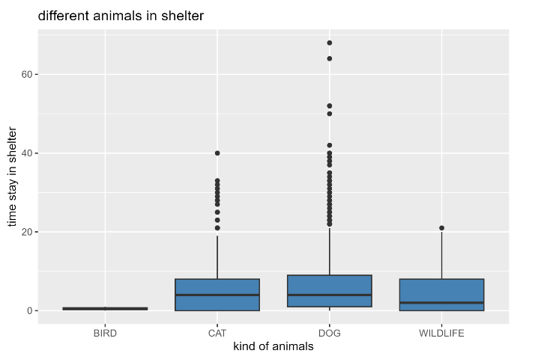
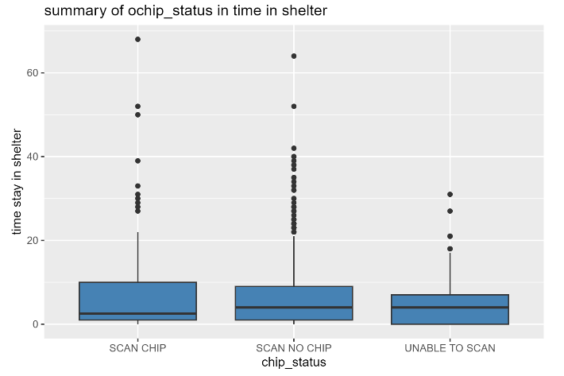
The Density Function Of Variables
The distribution of Animal type The distribution of Chip status

Slide 9
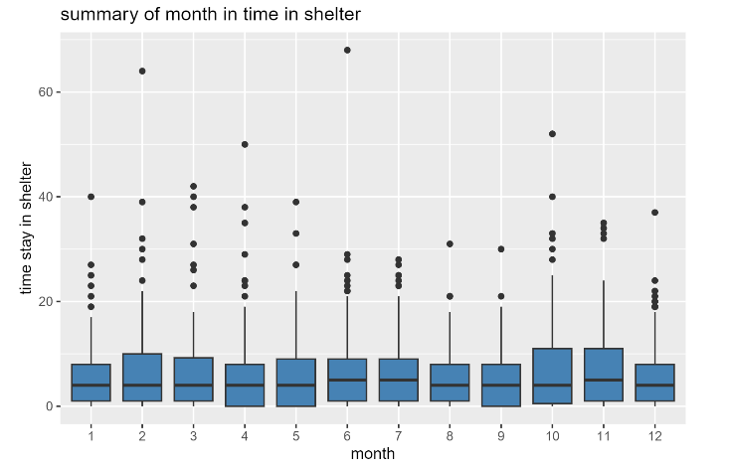
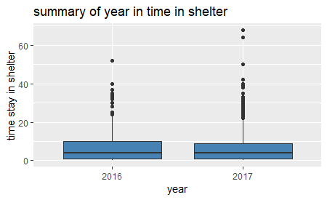
The Density Function Of Variables
The distribution of Month The distribution of Year

Slide 10
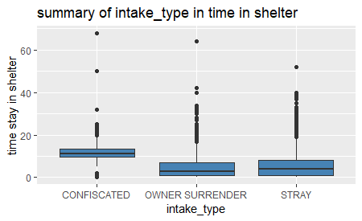
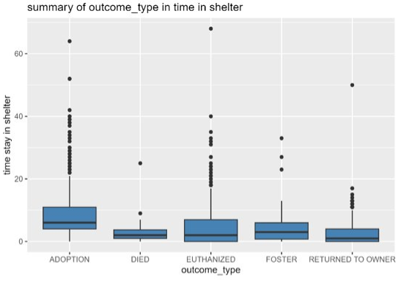
The Density Function Of Variables
The distribution of Intake type The istribution of Outcome type

Slide 11
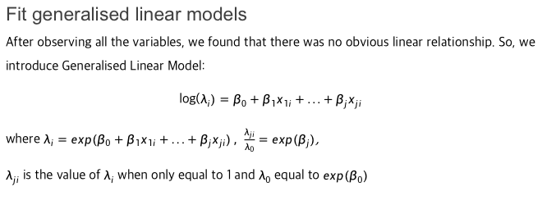
Model Analysis
Fit generalised linear models
After observing all the variables, we found that there was no obvious linear relationship. So, we introduce Generalised Linear Model:
log($λ_{i})=β_{0}+β_{1}x_{1i}+...+β_{j}x_{ji}$
where $λ_{i}=exp(β_{0}+β_{1}x_{1i}+...+β_{j}x_{ji}) , \frac{λ_{ji}}{λ_{0}}=exp(β_{j})$,
$λ_{ji}$ is the value of $λ_{i}$ when only equal to 1 and $λ_{0}$ equal to ${exp(β}_{0})$

Slide 12
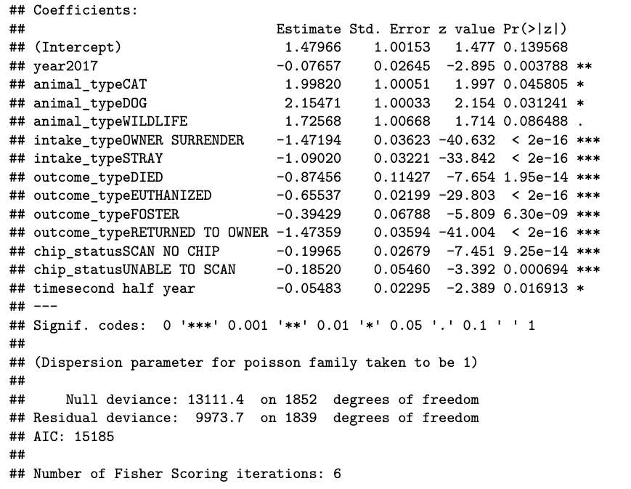
Model Analysis
Model 1
We first try to fit full model with the whole dataset.
There doesn't seem to be a significant difference between WILDLIFE and BIRD, so these two variables are considered group together
AIC = 15184.51

Slide 13
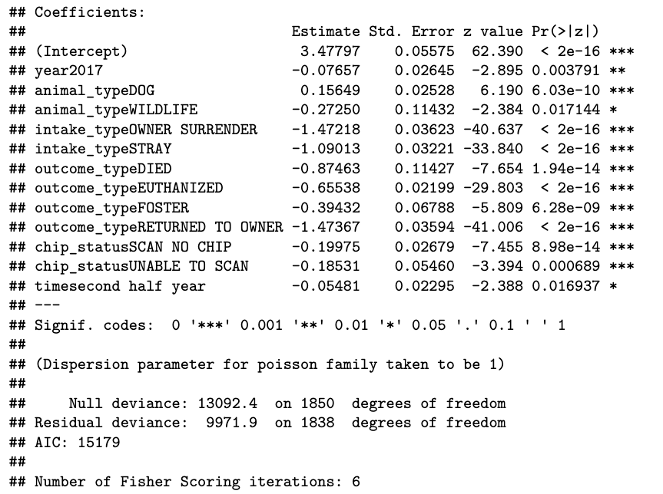
Model Analysis
Model 2
Since we know that small size of data would cause collinearity, we decided to exclude the data of BIRD. Then We fit a new model.
Compare these two models base on the value of AIC and p-value:
Model 1: AIC = 15185
Model 2: AIC = 15179

Slide 14
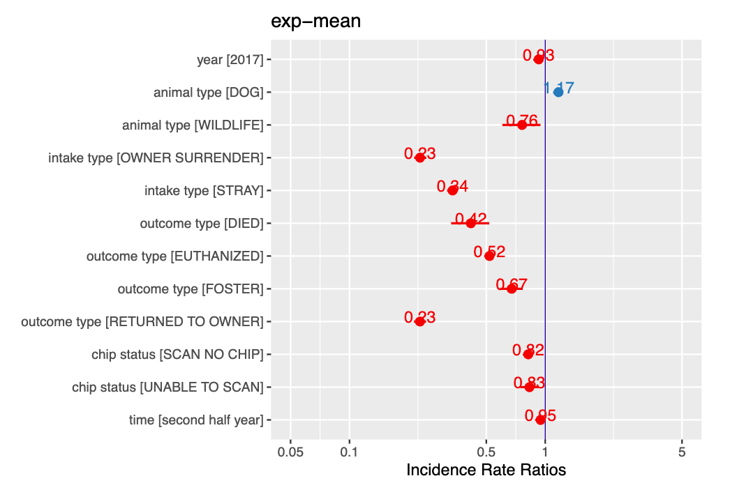
Model Analysis
However, we are also interested in producing a 95% confidence interval for these odds, and this can be displayed graphically.

Slide 15
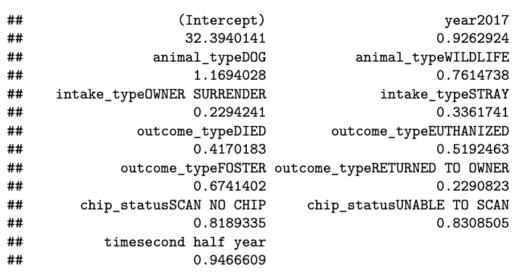
Conclusion
Coefficient of all variables in the model

Slide 16
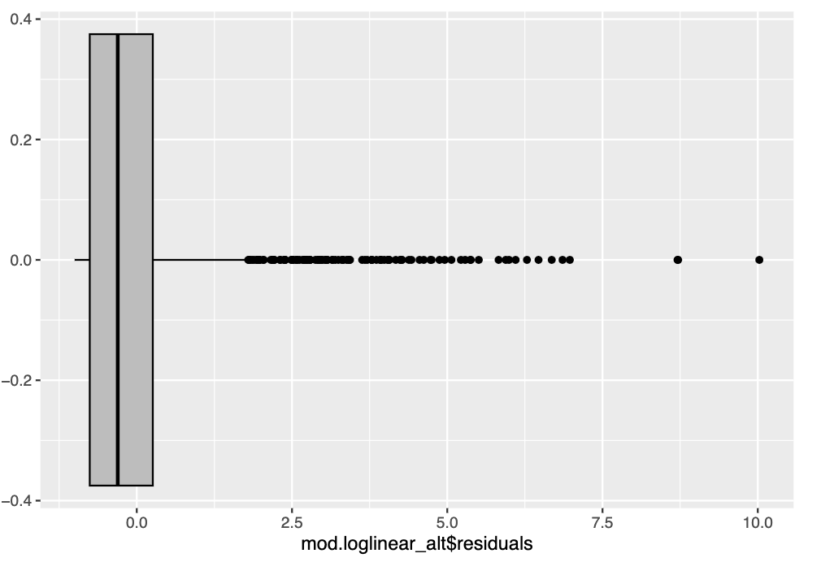
Conclusion
Finally, check if the residuals follow the assumptions theoretically by the theory of GLM.

Slide 17
Thank You

